Slide 1
Microsoft Power Platform

Slide 2
Day 2: Power Packed Day with Power Automate – Part II

Slide 3

Agenda
Introduction
Types of Power Automate
Data types and expression
Working with Arrays
Control flow and action settings
Demo

Slide 4
Get started with Power Automate

Slide 5
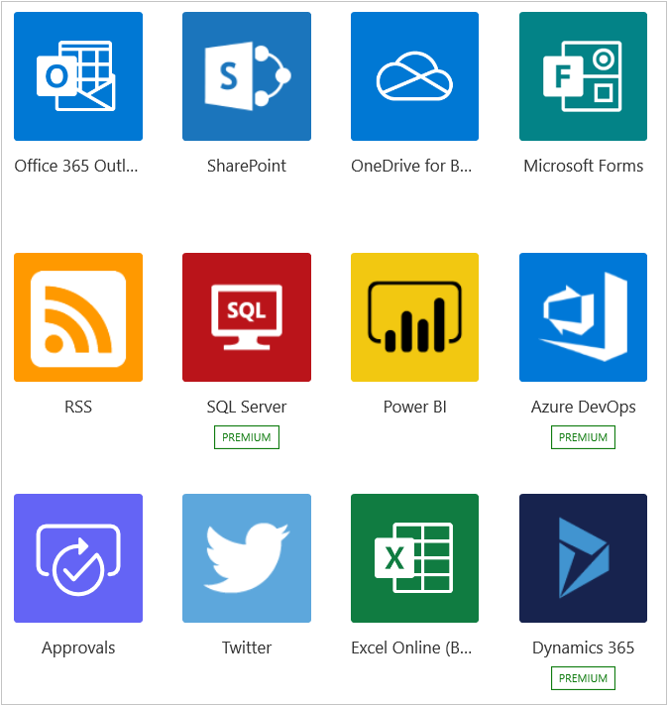

Introduction to Power Automate

Slide 6
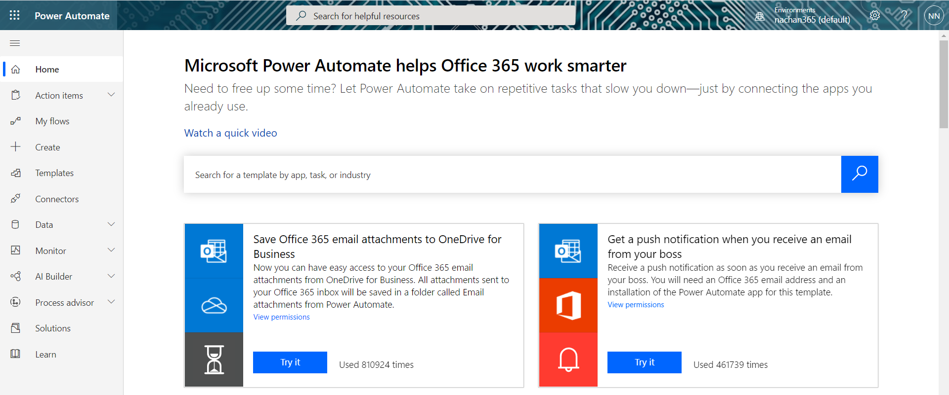
A brief tour of Power Automate

Slide 7
Create your first flow

Slide 8
Power Automate Desktop flow

Slide 9
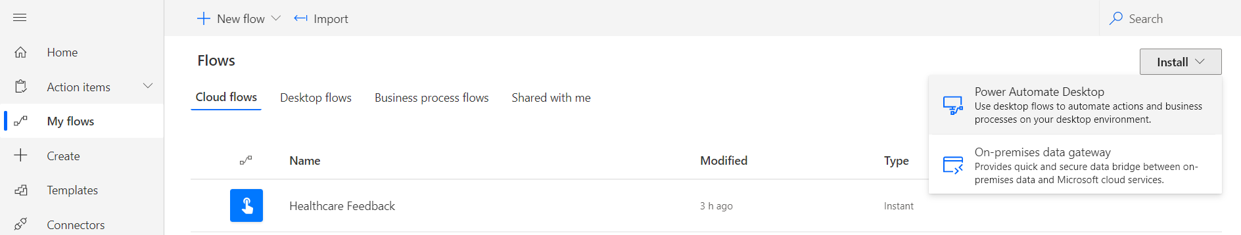
Software installation

Slide 10
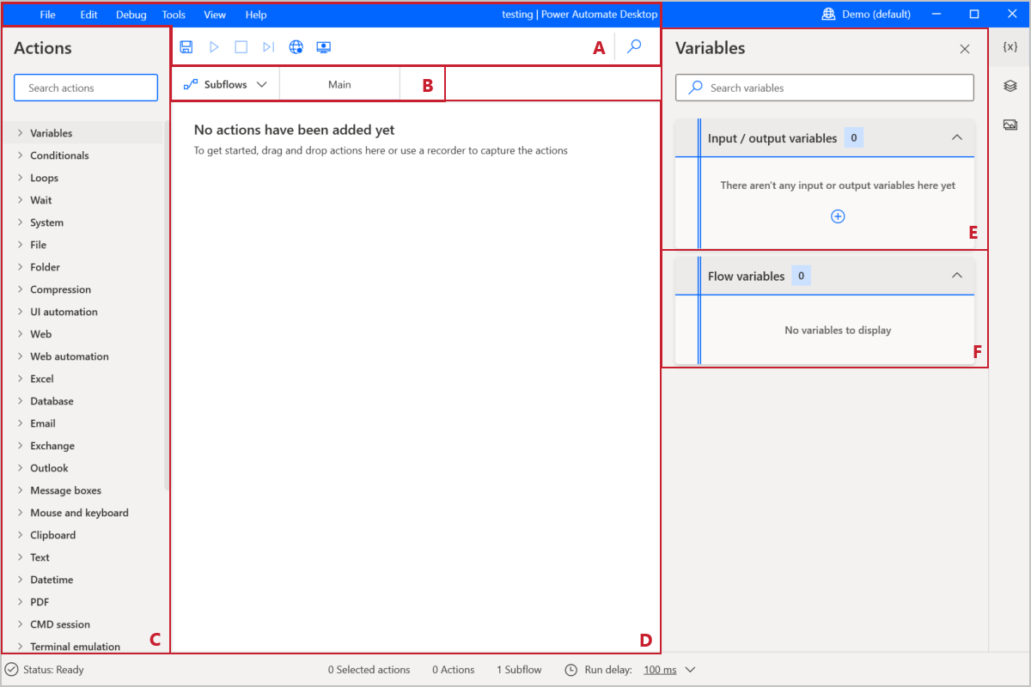
Explore Power Automate Desktop

Slide 11
Create your first Power Automate Desktop flow

Slide 12
Use the Admin center to manage environments and data policies in Power Automate

Slide 13
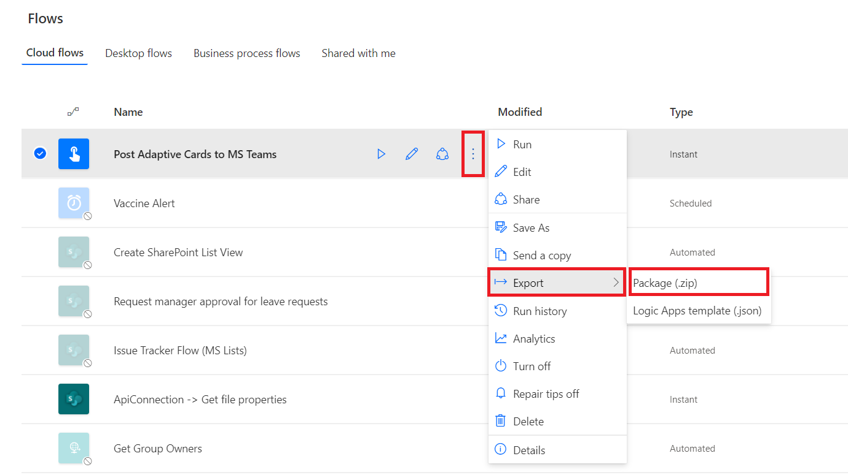
Export and import flows

